Slide 1

LLM-Powered Dashboard for Groundwater Climate Resiliency in South Florida
Ahmed S. Elshall, Ph.D.
Assistant Professor - Environmental Engineering
U.A. Whitaker College of Engineering
Joint Appointment with The Water School
Email: aelshall@fgcu.edu
Mewcha A. Gebremedhin, Ph.D.
Postdoctoral Research Scholar
U.A. Whitaker College of Engineering
Email: mgebremedhin@fgcu.edu
Notes:
Assisted Agents (Level 1): These are AI systems that support scientists in narrow, well-defined tasks.
Examples:
Literature search engines powered by LLMs.
Automated data cleaning or visualization tools.
Machine learning models for prediction (e.g., climate or groundwater models you might use in hydrology).
Key Feature: Human-in-the-loop is essential; the AI only assists.

Slide 2
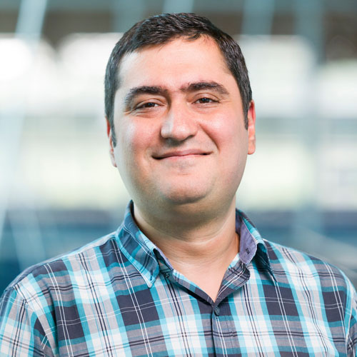


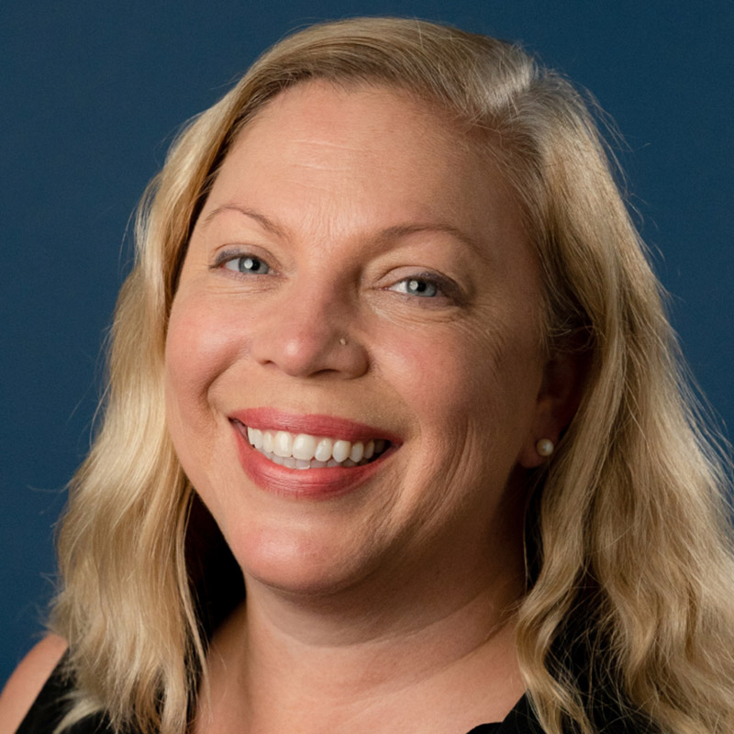






Nature-based Infrastructure for Enhancing Climate Resiliency of Groundwater Resources in South Florida
Ebrahim Ahmadisharaf, FSU
Ahmed Elshall, WCE and TWS
Mewcha Gebremedhin, WCE
Shelly Krueger, UF
Rachel Rotz, TWS
Seneshaw Tsegaye, WCE
Ming Ye, FSU
USGS Caribbean-Florida Water Science Center

Slide 3





Project Overview
Assess climate change impacts
Evaluate nature-based infrastructure for mitigation (local or regional)
Collaborative modeling
Web-based platform for data sharing
Groundwater education and outreach
Notes:
Quantifying the impacts of climate change on surface-groundwater interactions, groundwater resources, water quality in terms of salinity (undergoing). This is particularly related to the changing rainfall pattern and SLR rise under different scenarios
Collaborating with stakeholders to evaluate nature-based infrastructure for mitigation and adaptation solutions (Next step). This could be at local or regional scale (any suggestion on this would be also appreciated)
Conducting outreach campaigns to increase community awareness about the resilience of groundwater resources in South Florida (using different outlet medias).
Developing a user-friendly web-based platform to provide stakeholders with access to project data, supporting decision-making and community engagement. This helps to the goal of making data FAIR: Findable, Accessible, Interoperable, and Reusable

Slide 4
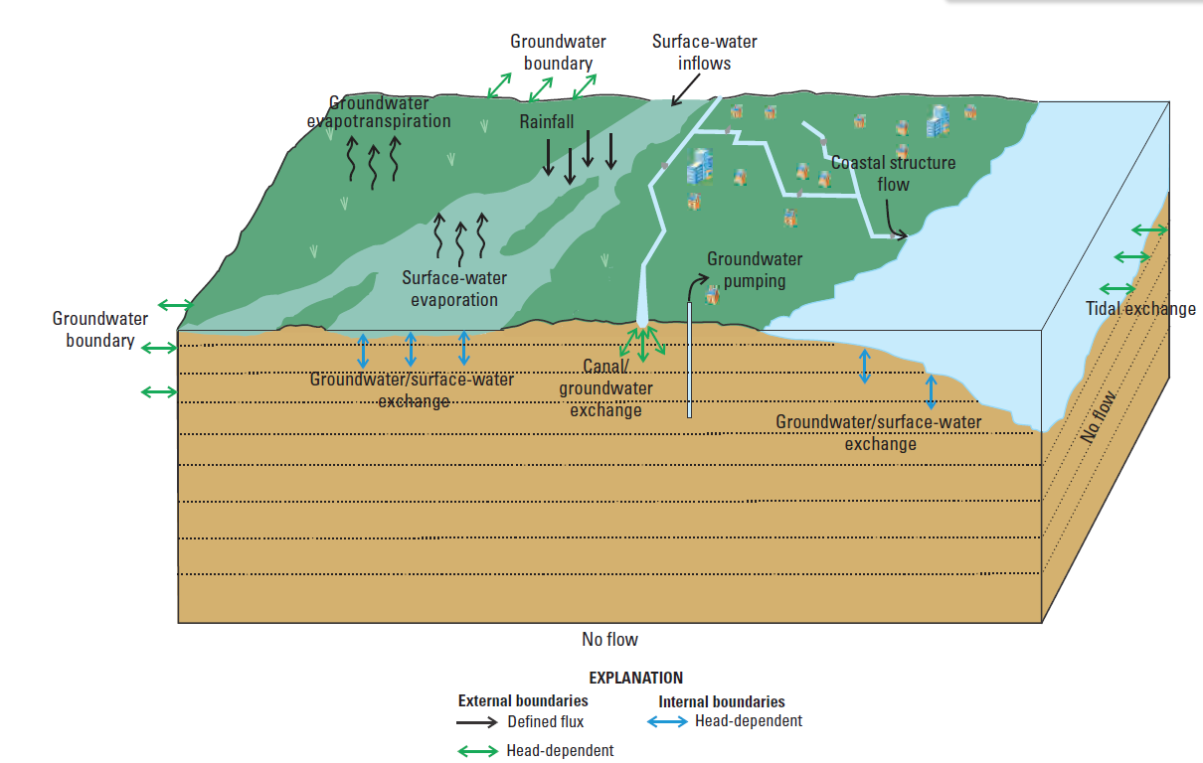
Project assesses climate change impacts and mitigation measures using numerical models
Slough
Biscayne and Southern Everglades Coastal Transport (BISECT) model (Swain, et al. 2019, USGS)
Notes:
Conceptual model of the hydrologic system of the Biscayne and Southern Everglades Coastal Transport (BISECT) model (Swain et al., 20219)

Slide 5
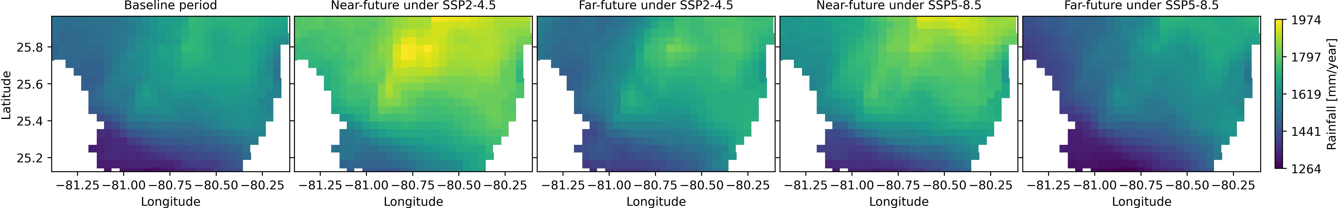
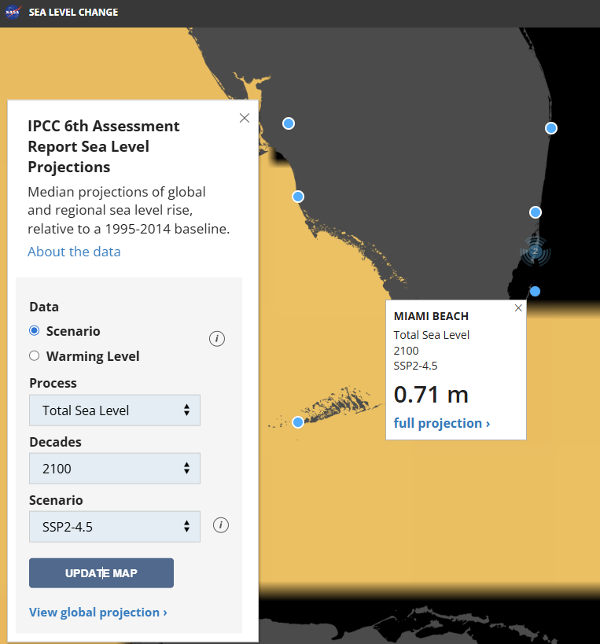
Model Inputs include climate projections with baseline and future temporal coverage
Rainfall, CMIP6 - Oak Ridge National Laboratory
Sea-level Rise, CMIP6 - NASA
Notes:
NetCDF data
Intergovernmental Panel on Climate Change (IPCC) Sixth Assessment Report (AR6)
Downscaled CMIP6 climate projections
SSP2-4.5 and SSP5-8.5 scenarios
NASA projections
Temporal Coverage
Baseline: 2011–2019
Near-future: 2051–2059
Far-future: 2091–2099

Slide 6
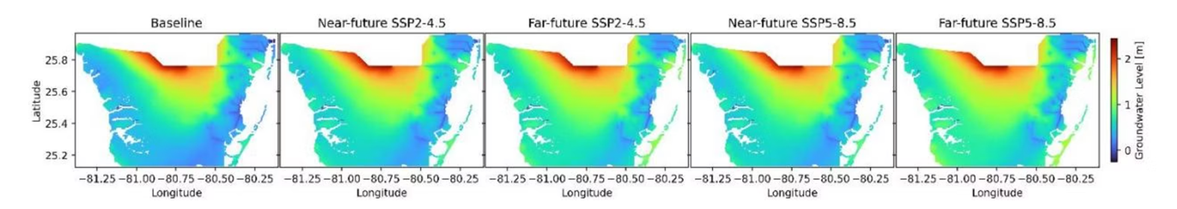
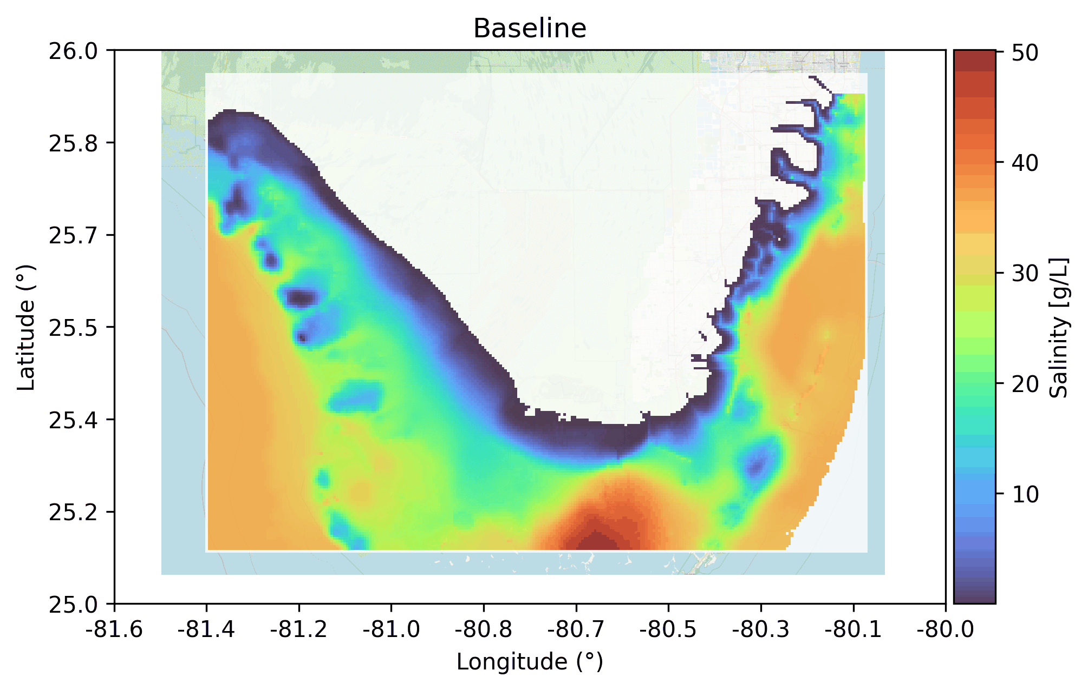
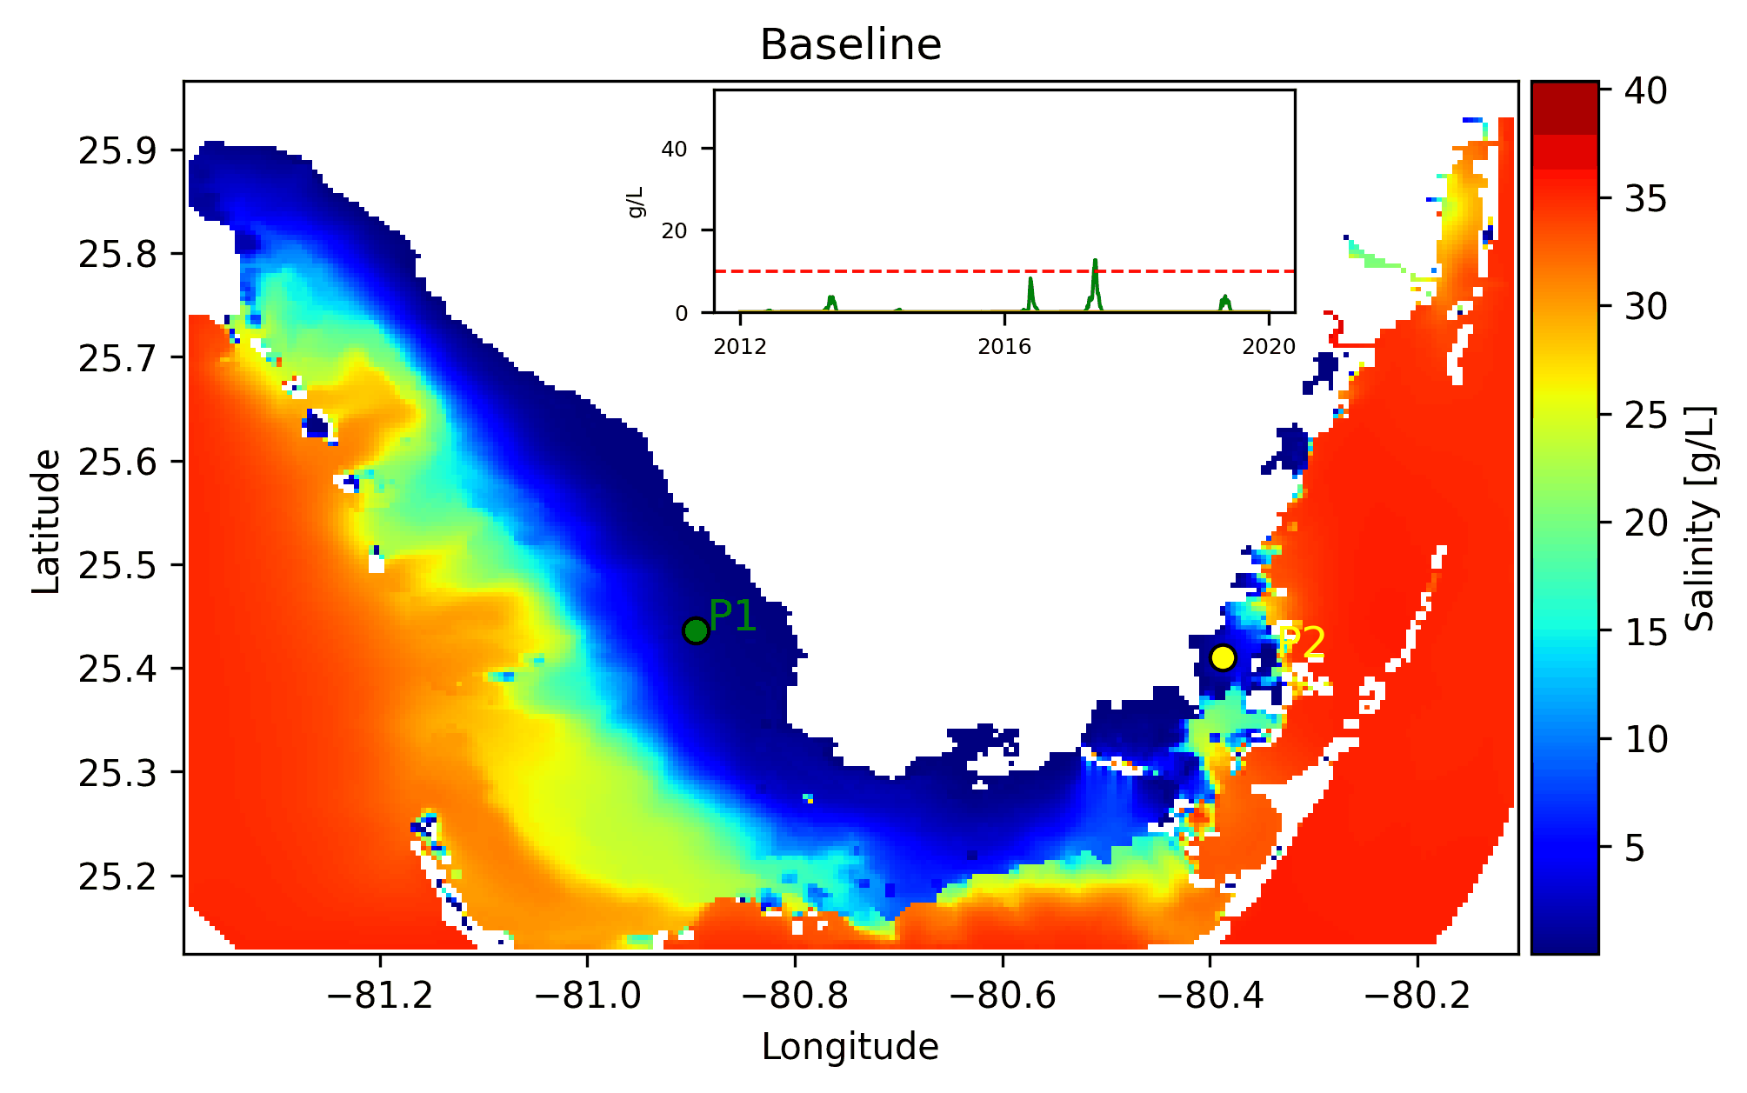
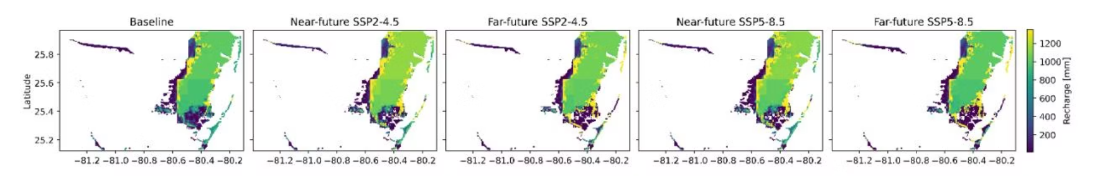
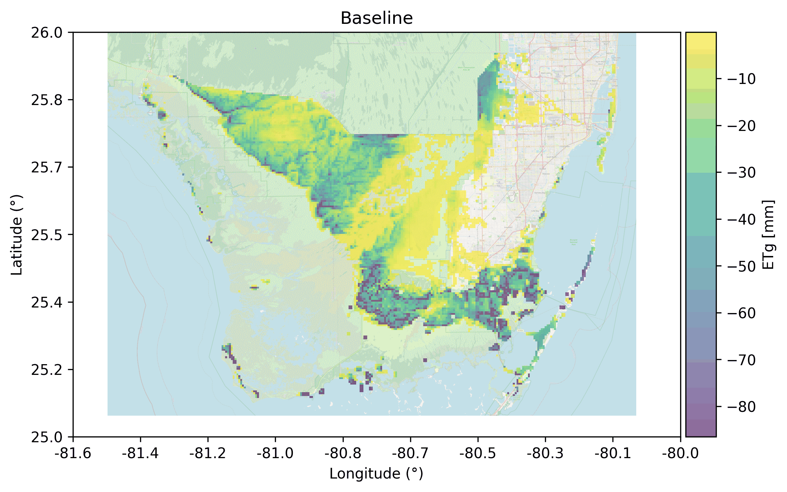
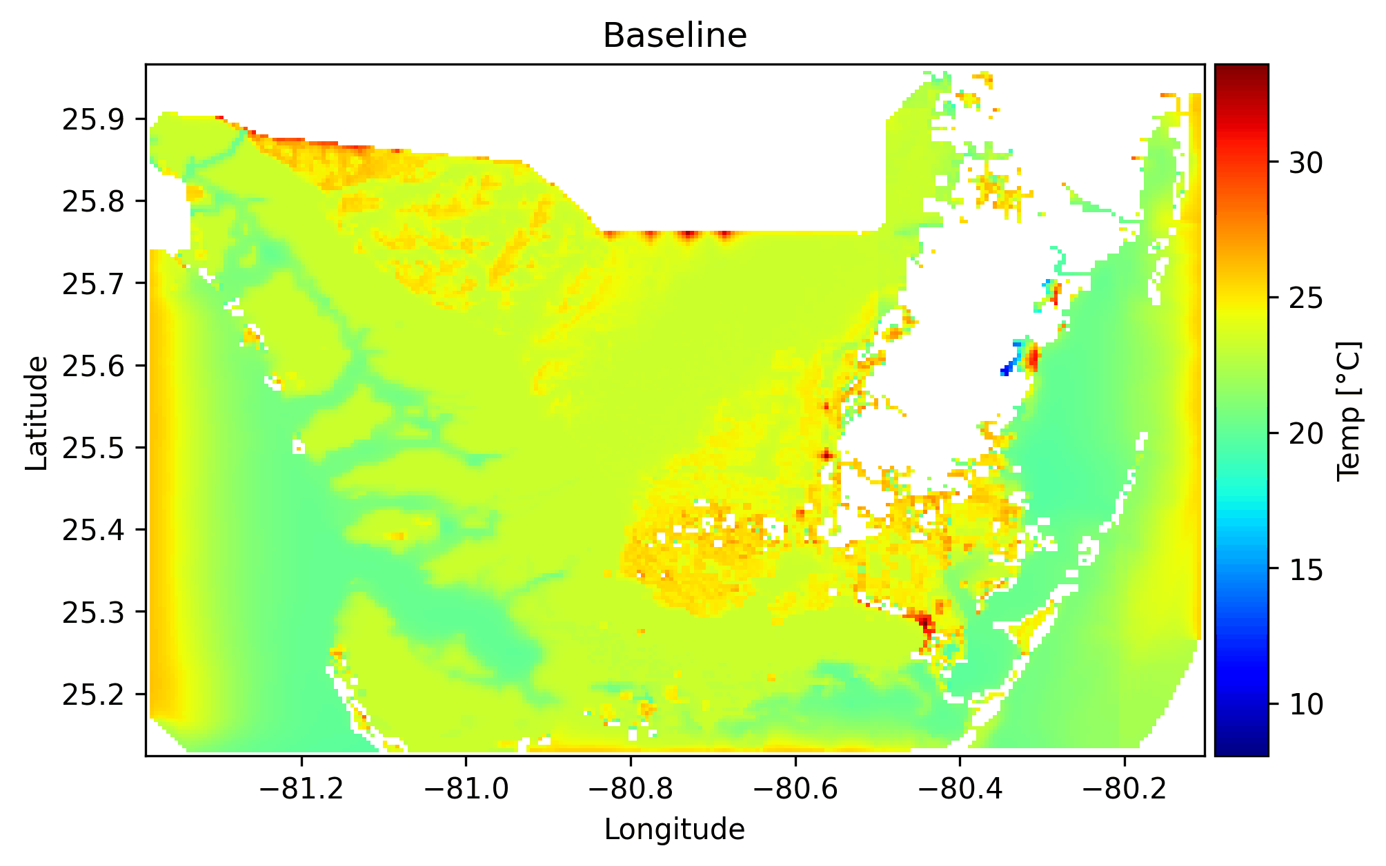

Model outputs are critical for diverse stakeholders at South Florida
Groundwater Levels
Groundwater Salinity
Surface-water Salinity
Groundwater Recharge
Groundwater Evapotranspiration
Surface-water Temperature
Notes:
Model Outputs (different data formats)

Slide 7
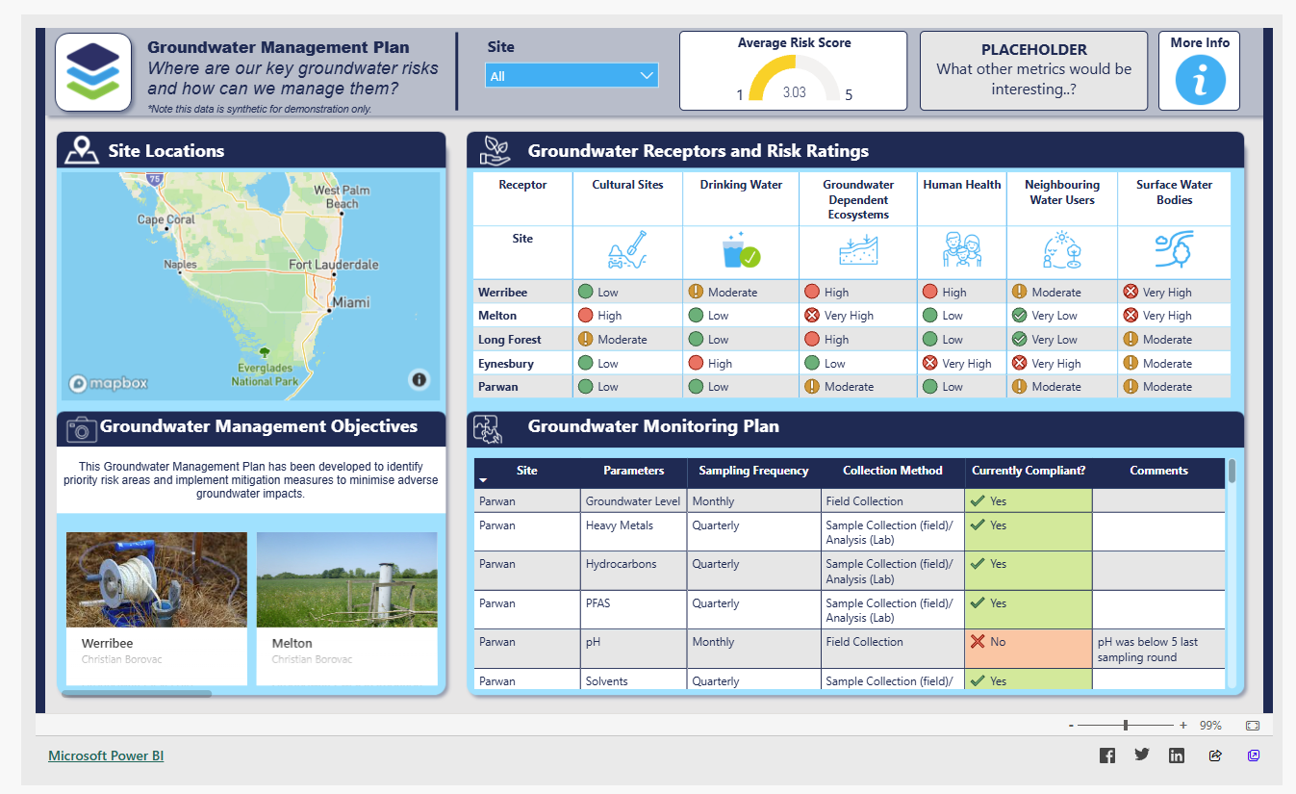
LLM-powered Dashboard: Innovation in stakeholder engagement to synthesize complex information to actionable recommendations
Image Credit: https://community.fabric.microsoft.com/t5/Data-Stories-Gallery/Visual-Storytelling-An-Environmental-Risk-Assessment/m-p/1342550?utm_source=chatgpt.com
Notes:
Dashboard Purpose: Interactive platform for stakeholders, scientists, water resource managers, and the public
LLM-powered decision-support dashboard is an innovation in stakeholder engagement, designed to synthesize complex information—including rainfall, groundwater recharge, evapotranspiration, water quality, and flood data into actionable recommendations.

Slide 8
Project support
Provide project datasets and guidance on Python packages
Assist with the design of browser-based UI
Manuscript mentorship for high-quality peer-reviewed publication
Cover open-access publication fees
Provide full travel support for 1 student (or 2 going together) to present at a national conference (e.g., AGU Fall Meeting, San Francisco)
Collaborative teamwork through the project
Notes:
Project datasets and workflows, plus guidance on required Python packages
Frontend guidance for a browser-based UI
Manuscript mentorship with the goal of a high-quality peer-reviewed publication (beyond a capstone report)
Open-access publication fees covered
Travel support for 1 student (or 2 going together) to present at a national conference (e.g., AGU Fall Meeting, San Francisco - One week).
Hands-on experience with geospatial big data
Graduate school preparation
Strong resume (working on an EPA funded grant and CMIP6 data)

Slide 9
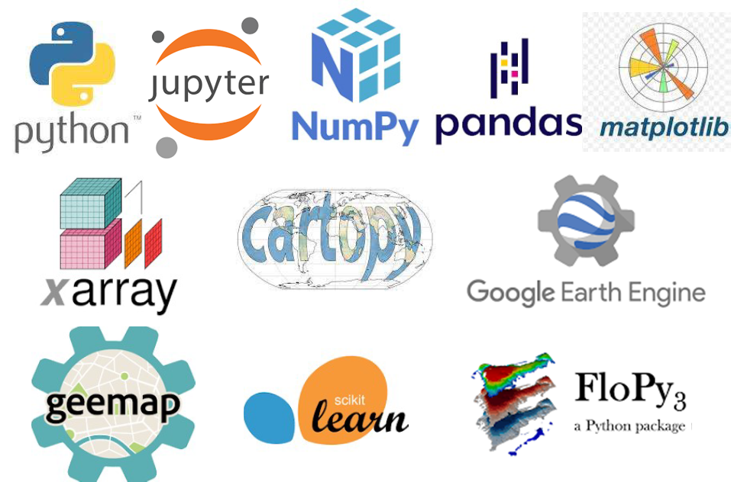

Scan for more Information and to apply
Advertisement: TA Position for Spring 2025
EGN 4930 / EGN 5932C
Environmental Data Science

Slide 10

Thank You
Questions?
https://aselshall.github.io/ads/ai
Scan for slides and more information

Slide 11
Extra slides

Slide 12




Dashboard Core Features
AI Interaction
Interactive Homepage
GenAI chat interface for natural language queries about climate impacts
User-friendly entry point with in-built navigation to all dashboard modules
Data Visualization
Data Upload and Download
Upload model input/output data in various formats (NetCDF, GeoTIFF, Binary, ASCII) and download based on query
Visualize temporal and spatial variables through interactive maps and time series plots

Slide 13



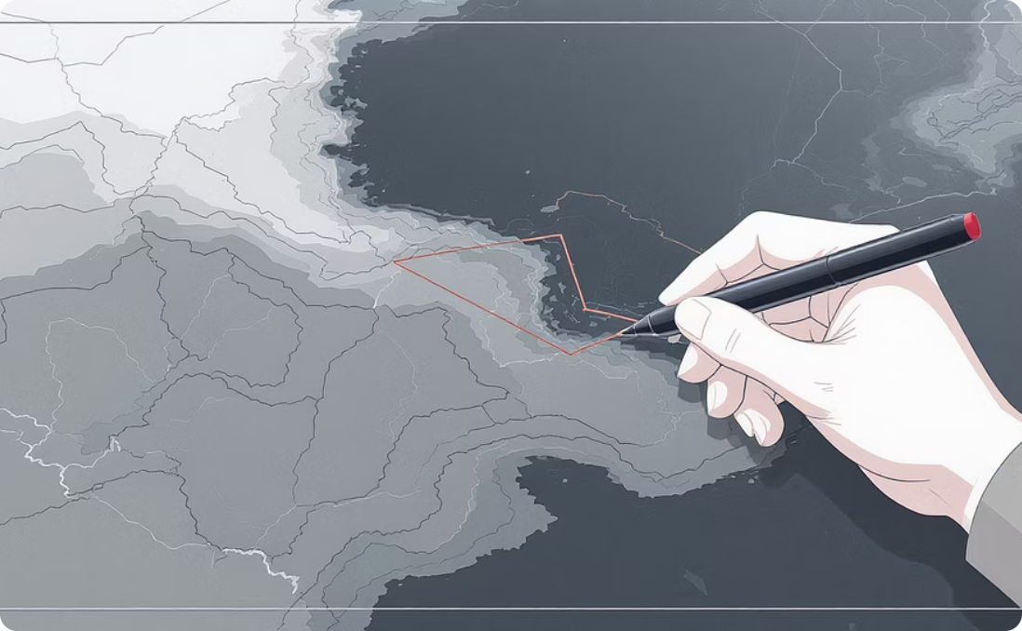
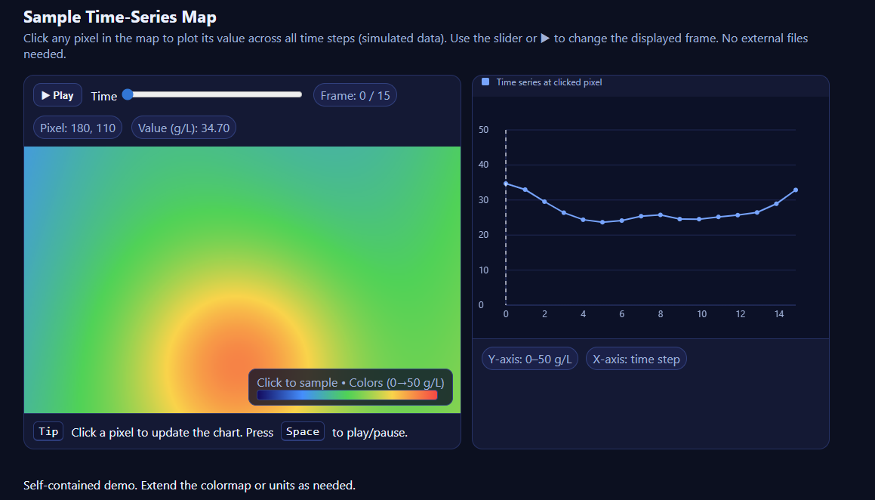
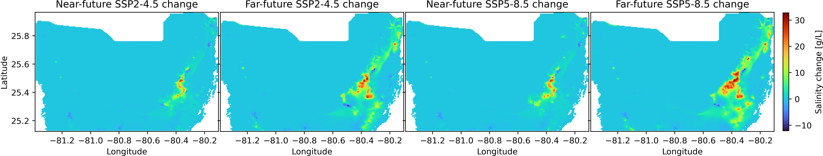
Interactive Map & Time Series Features
Interactive Map Viewer
Mapbox with base map allowing users to draw points or polygons and view variable overlays
Time Series Explorer
Generate plots from selected areas with comparison across scenarios and time periods
Example
Scenario Comparison
Side-by-side comparisons highlighting significant changes between time periods and scenarios

Slide 14
LLM-Powered Decision-Support
GenAI Chat Interface
Natural language query capabilities:
"How will the water table change in Miami Beach by 2099 under SSP5-8.5?“
Provides textual summaries of complex data
Links directly to relevant visual data
Translates technical information for non-experts
Data Export Capabilities
Download options for research and reporting:
Selected time series data (e.g. CSV)
Map layers (e.g. PNG, GeoTIFF)
Statistical summaries
Comparison reports

Slide 15
Additional Features
Future NBIF Module
The dashboard architecture will be designed to accommodate a future module focused specifically on Nature-Based Infrastructure Features (NBIFs).

